Slide 1
General meeting 03.11.2022
Sjur Beyer

Slide 2
Contents/motivations
Second to last meeting of the semester
This will be a status update

Slide 3
Progress
~1000 lines of code has been written
Many model runs have been done to test the model
Optuna is implemented
Multiple outputs have been implemented
Automatic model naming schemes and storing configs
Model overfits well to unprocessed seismic data

Slide 4
Architectures
I think it is reasonable to only focus on TCN
Possible to make reference to publications by Mustafa
LSTM; audio, CNN; image
Seismic === Audio image

Slide 5
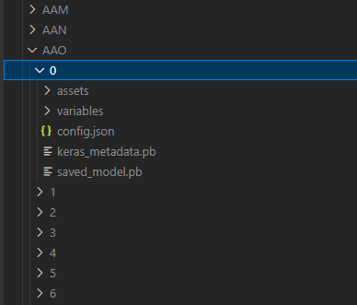
Folder structure
Tree letters denoting group name
Total 26^3 = 17 576 combinations
Models are given a number starting at 0
A model name will then be Groupname / Modelnumber

Slide 6
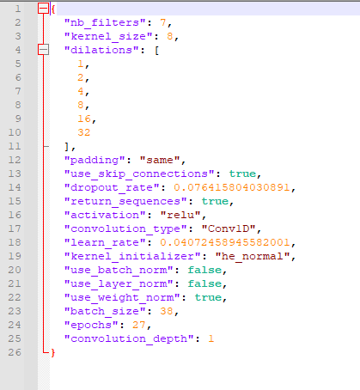
Model configs
These are saved in the .json file
These parameters get tweaked by optuna, so I save them to be able to compare what the good performing models have in common
Planning to add ‘feat_aug_dataset’ to have optuna decide what additional data preprocessing is preferable

Slide 7
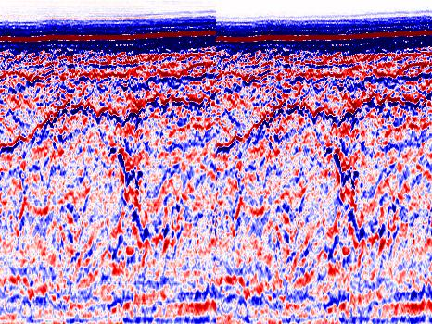
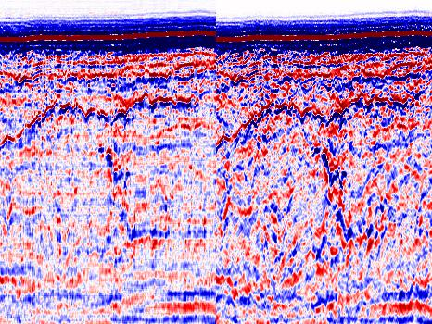
Reconstruction

Slide 8
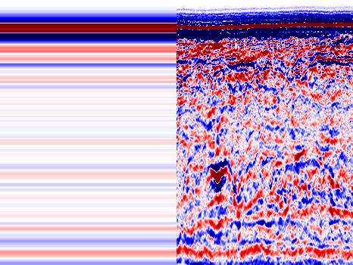
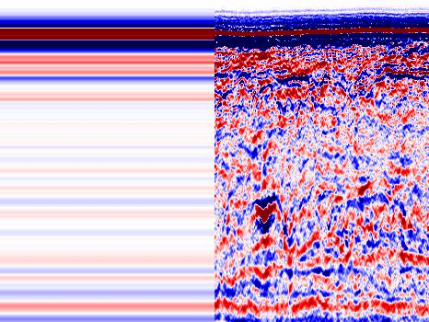
Not just a kernel size issue (these had ks=8)

Slide 9
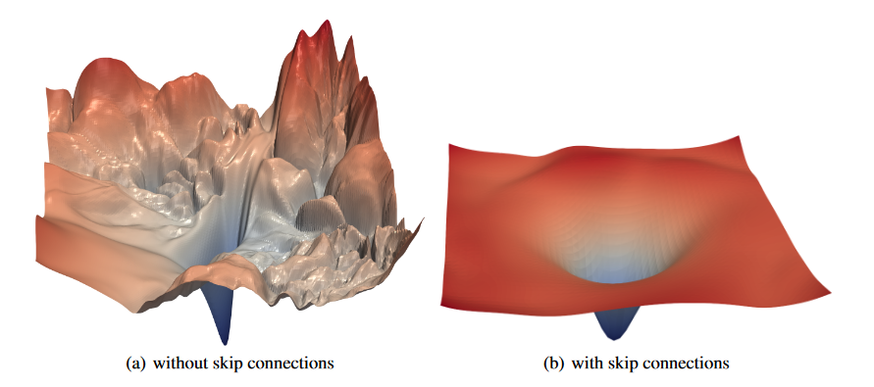
Errors might just be bad regions of loss landscape

Slide 10
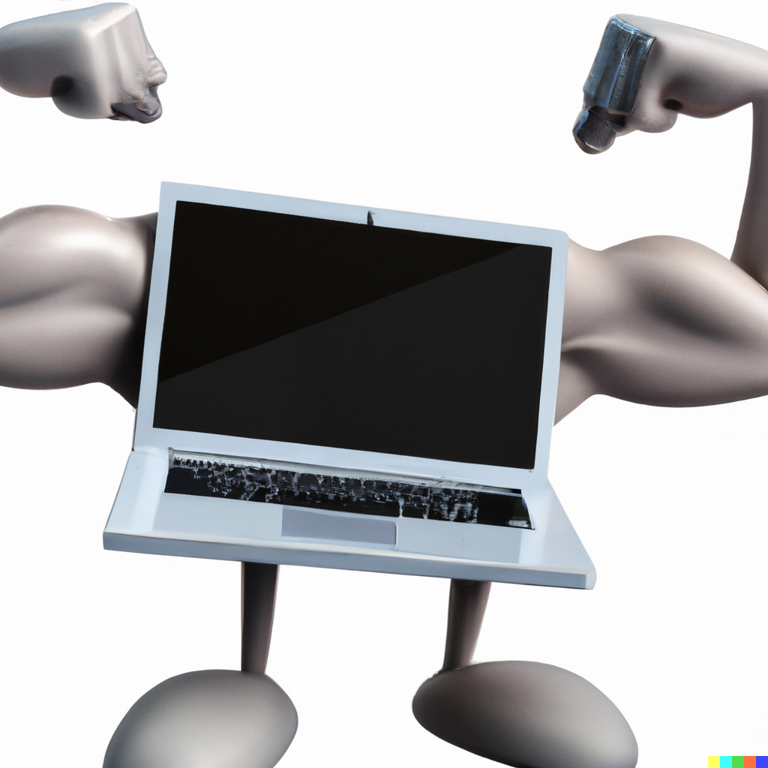
Profiling
Where is the code running | Time per step [ms/step]
NGI Laptop | ~270
Odin w/ # users = ? | ~587
Odin w/ # users = 2 | ~360
Desktop with RTX A2000 | ~35*
* This was running the model with much longer traces and also multiple outputs
This means that I will be able to train 10x as many models, and explore a larger area of the weight space

Slide 11
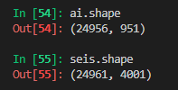
Current phase: Data processing
I expect to get started on:
Robust automatic dataset generation
Data preperation
Normalization, extracting outliers etc
Correlation of seismic and target:
Seismic traces and cpt-locations/ai
-> Cardinality issue
first value is slightly different

Slide 12
State of affairs
Cardinality issue, and good dataset management is the only thing thats preventing me from running lots of models.
How to do good correlations?
GPS data in sgy?
Also need to do correlation by depth
What depth is of interest

Slide 13
Further work
Visualization script still has not been written
Will incorporate:
Loss function over time
Best & worst areas for reconstruction (monochrome w/ red details for error)
Image of target prediction
List over what datasets were used
Summary statistics
Some model input parameters
TensorBoard is soon up and running:
Only needs a little troubleshooting…
This will allow for me to see how well the training is utilizing the GPU
May look at using 16bit float for increased computation power
Huge flatten layers..

Slide 14
Further work cont.
Geotechnical parameters and evaluating prediction capabilities
Reading through the reports and finding good sources
Writing.. (hopefully a lot of time while models run)

Slide 15
Scope and ambition adjustment
I think I can manage to get feature augmentation done before christmas
In that case I will be having the desktop running optuna all through christmas, and hopefully have some nice model results for January
My last day of the semester will be 19th of December
Last general meeting for the semester will then be on 1.12.2022

Slide 16
When to start up next semester?

